Slide 1
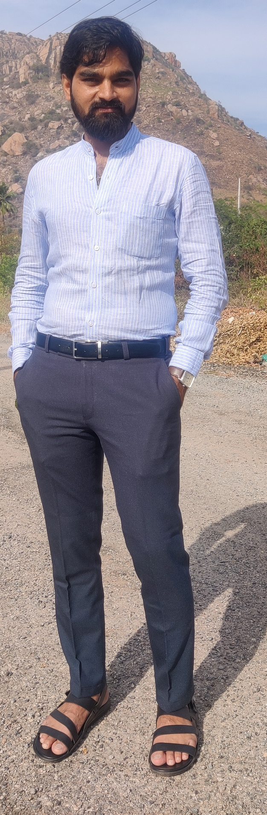
Personal Details
Name : Keshavamurti K Vadavi
Native : Gadag
DOB : 09-01-1996
Gotra : Bharadhdwaja
Rashi : Simha
Nakshatra : Magha
Profession : Sr.Tech Specialist at
Brillio Technologies,Bengaluru.
Salary : 18LPA
Height : 5’ 8”
Family Details
Father’s Name : Krishnacharya
Vadavi
Mother’s Name : Satyabhama
Brothers/Sisters : 1 Elder Brother
Address : #256, 4thMain Road,
Stage1, KHB Colony,
Basaveshwarnagar,
Bangalore
Asset : Own House in Native
Contact Details
9620008622
8095208793

Slide 2
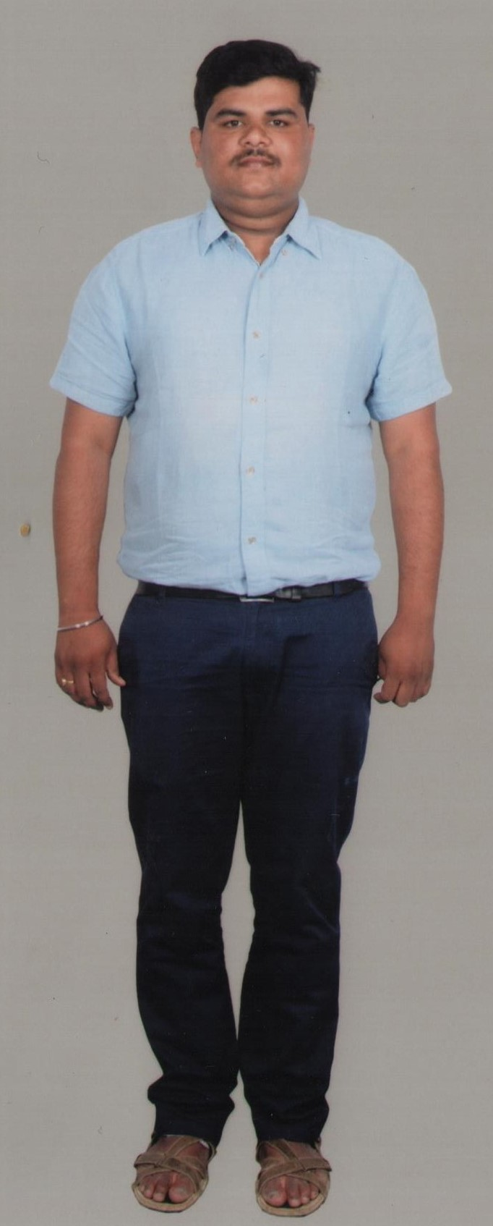
Personal Details
Name : Venkatesh K Vadavi
Native : Gadag
DOB : 05-07-1992
Gotra : Bharadwaja
Rashi : Simha
Nakshatra : Poorva
Profession : BNB Secucrity & Automation Solutions Ltd.Bengaluru
Designation : Project & Service Engineer
Salary : 8.5 LPA
Height : 5’ 9”
Family Details
Father’s Name : Krishnacharya Vadavi
Mother’s Name : Satyabhama
Brothers/Sisters: 1 Younger Brother
Address : #256, 4thMain Road,
Stage1, KHB Colony,
Basaveshwarnagar,
Bangalore
Asset : Own House in Native
Contact Details
Cell : 9591577146
8095208793

